Slide 1
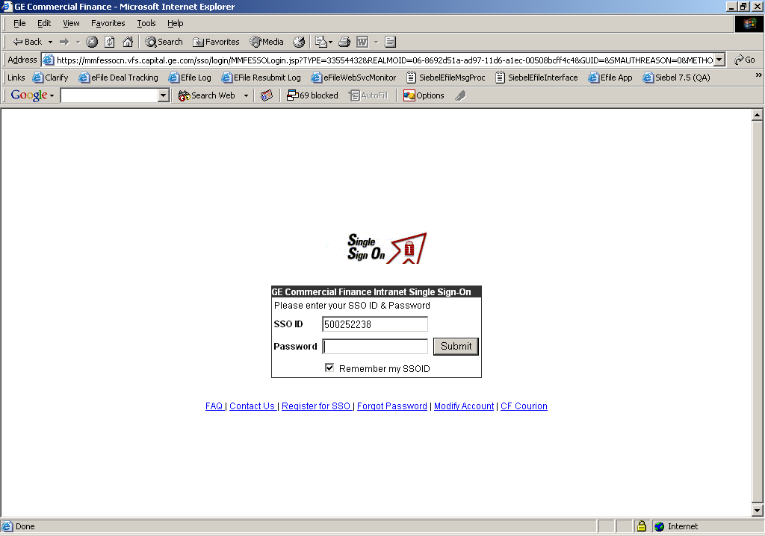
Login Page

Slide 2
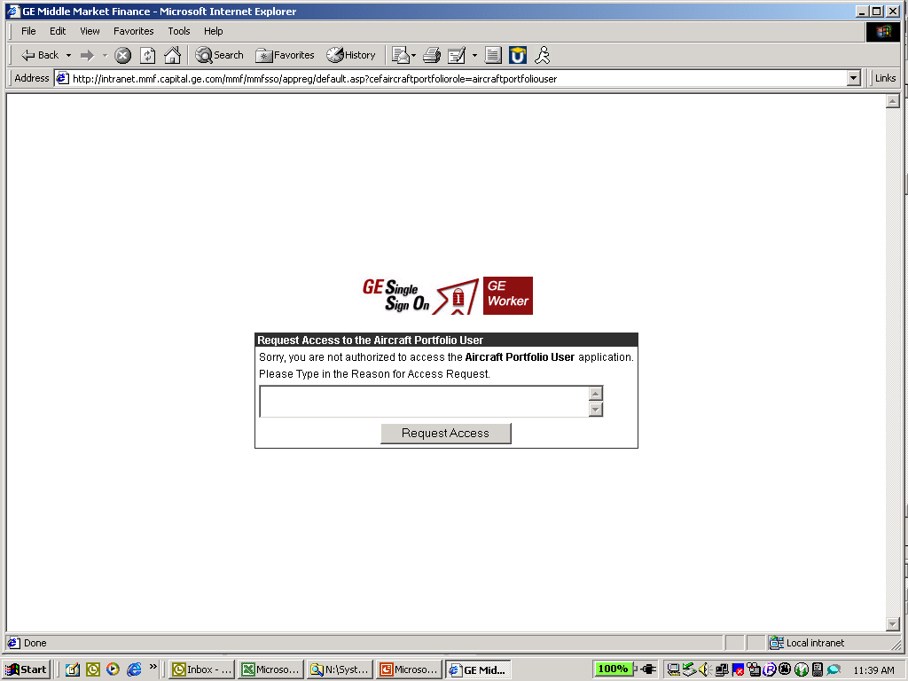
Access Deny - Grant access to the system – Admin tool
This is what a person would get when they tried to log into the system
So you could have a home page with other stuff on it and have a login.

Slide 3
Welcome <First Name> <Last Name>
Show the list of all Money Cost File that the Logged in User can update
Money Cost File
Index Rates
Col Position
1
2
3
4
5
Code
CP1
CP3
Prime
US Treasury 1
US Treasury 2
Description
Commercial Paper1
Commercial Paper1
Percentile
Yes
Yes
Yes
Yes
No
Adder
0.081
0.081
0.90
0.81
0.81
Effective Date
01/01/2005
01/01/2005
01/01/2005
01/01/2005
01/01/2005
Update All
Adder Rate
Effective Date
Update All
Upon selection of a money Cost file, Fetch all the Rates for the MC file with following details but Only Adder & Effective date can be updated by the user.
Update All should update all the Index Rates Adder values with the value in the Text Box.
Update
Cancel

